Slide 1


Kuroyefa Leghemo
Sales Performance Dashboard – Swift Cart Hub
Data Analytics Project

Slide 2
Business Context
Swift Cart Hub operates in a competitive e-commerce environment where tracking sales, customer interactions, and operational efficiency is critical.
However, decision-making is limited without a centralized view of performance metrics.

Slide 3

Problem Statement
Lack of centralized analytics dashboard
Difficulty tracking key performance indicators (KPIs)
Limited visibility into sales and regional performance
Inefficient decision-making due to fragmented data

Slide 4
Objective
Develop an interactive Excel dashboard
Centralize key business metrics
Enable KPI monitoring and trend analysis
Support data-driven decision-making

Slide 5
Key Business Questions
01.
02.
03.
04.
05.
How is revenue trending over time?
Which regions generate the most sales?
Who are the top-performing sales representatives?
How efficient are customer interactions (call time vs sales)?
What is the current level of customer satisfaction?

Slide 6
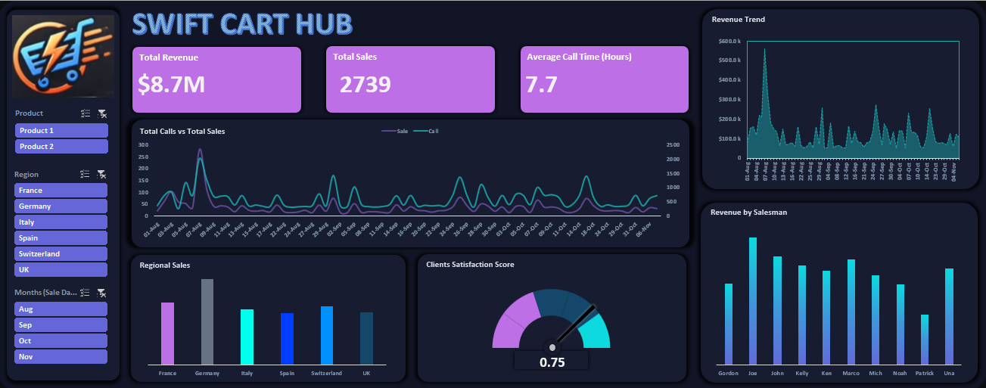
Dashboard Overview
Notes:
This dashboard provides a centralized and interactive view of:
Revenue, sales, and call efficiency
Regional and salesperson performance
Customer satisfaction metrics

Slide 7
Key Metrics (KPIs)
Total Revenue: $8.7M
Total Sales: 2,739
Average Call Time: 7.7 hours
Customer Satisfaction Score: 0.75

Slide 8
Key Features
Interactive slicers (Product, Region, Month)
Revenue trend analysis
Sales vs calls comparison
Regional sales breakdown
Salesperson performance tracking
Customer satisfaction gauge

Slide 9
Insights
Key Insights:
Revenue shows high volatility, with sharp spikes indicating seasonal demand or promotional impact
Germany was the top-performing region, contributing the highest sales among all regions
Sales performance varies significantly across representatives, highlighting opportunities for performance optimization
There is a positive relationship between call volume and sales, suggesting that increased customer interactions contribute to higher conversion rates
Customer satisfaction score (0.75) indicates moderate satisfaction, with room for improvement

Slide 10

Business Impact
Unifies business metrics in one view
Enables faster and more informed decision-making
Identifies high-performing regions and sales reps
Identifies customer engagement (calls) as a key driver of sales performance
Supports strategies to improve customer satisfaction and profitability

Slide 11

Tools & Skills
Microsoft Excel
Pivot Tables & Charts
Data Cleaning & Transformation
KPI Development
Dashboard Design

Slide 12
Conclusion
The dashboard improves visibility into key operations in SwiftCart Hub
Enables proactive decision-making

Slide 13
Thank you very much!

